Slide 1
ESLab: Sharing Resources
Missy Holzer
mholzer@monmouth.com

Slide 2
An Assortment
Jules Verne Explorer (MS ESS1—3)
Sterling Hill Mining Museum
NGSS Transition Workshops
Rider University STEM Education: Online Graduate Courses & Certificate Program

Slide 3
Jules Verne Explorer
Assists students in developing proficiency toward this and other PEs:
MS-ESS1-3. Analyze and interpret data to determine scale properties of objects in the solar system.
DCI: Earth and the Solar System
SEP: Analyzing and Interpreting Data
CCC: Scale, Proportion, and Quantity
Remember: To be NGSS congruent – be sure to BLEND your lessons!
Tutorial for teachers: EET Chapter - Creating Custom Map Images of Earth and Other Worlds

Slide 4
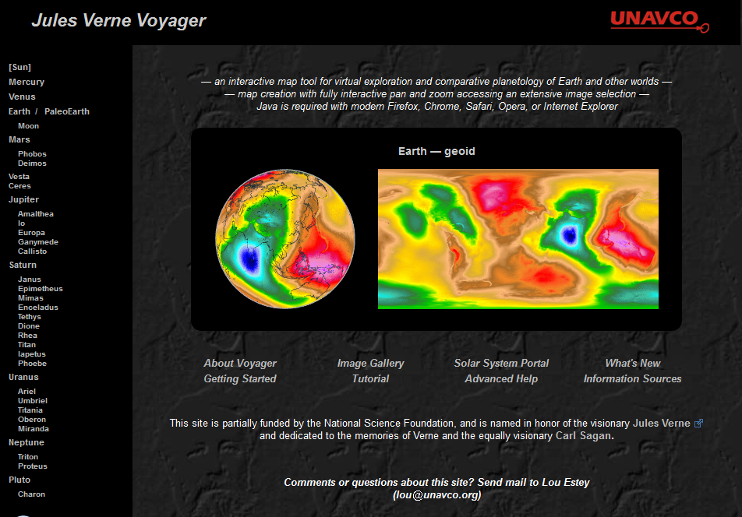
Jules Verne Explorer
http://jules.unavco.org/

Slide 5
Another Option
Google Earth: Access to the Moon and Mars

Slide 6
Sterling Hill Mining Museum
Assists students in developing proficiency toward this and other PEs:
MS-ESS2-1. Develop a model to describe the cycling of Earth's materials and the flow of energy that drives this process.
DCI: Developing and using models
SEP: Earth’s Materials and Systems
CCC: Stability and Change

Slide 7
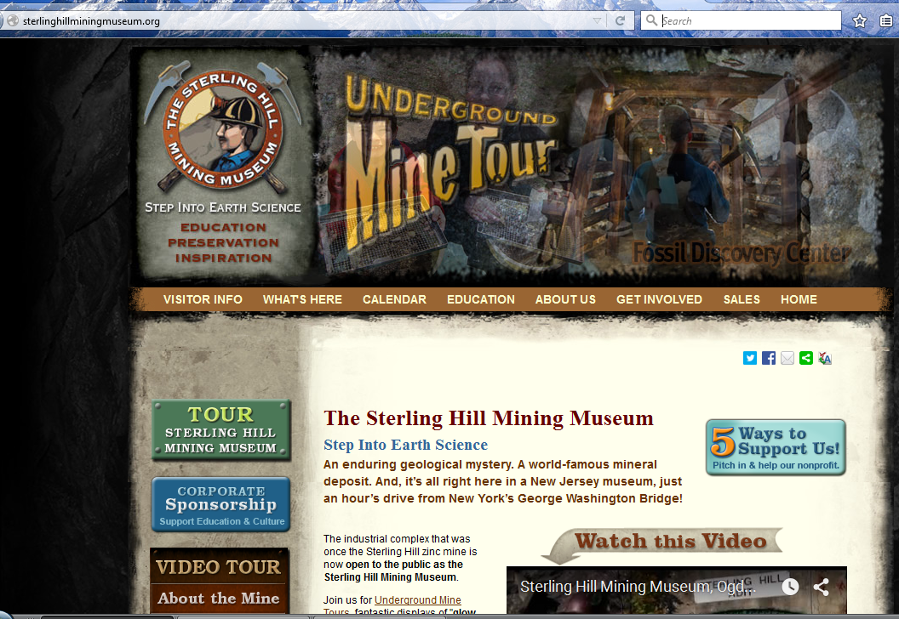
Sterling Hill Mining Museum
http://sterlinghillminingmuseum.org/

Slide 8
NJESTA sponsored NGSS Transition Workshops
Who: MS & HS Earth & Space and Environmental Science Teachers
What: An active workshop providing assistance with deciphering the NGSS and transitioning our teaching methods in support of the NGSS
Logistics:
Saturday February 6th at the Greater Newark Conservancy
Saturday February 20th at the Palmyra Cove Nature Park
Phase 2: Online follow-up
Workshop Fee: $10

Slide 9
Rider University
STEM Education: Online Graduate Courses & Certificate Program

Slide 10
mholzer@monmouth.com
For answers to questions about any of these resources, contact me at

